Slide 1
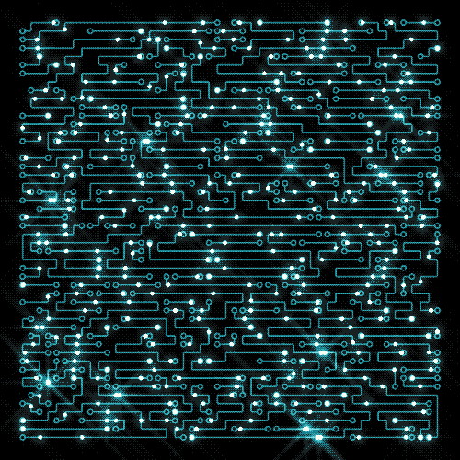
Introduction to
Circuits

Slide 2

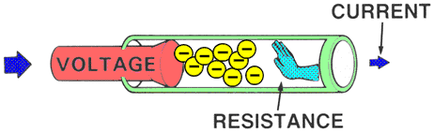
Overview
Ohm’s Law Review
Basic Circuit Elements
Schematic Symbols and Real life
Series and Parallel Resistances
Voltage Division
Open and Short Circuit
Kirchhoff’s Laws

Slide 3
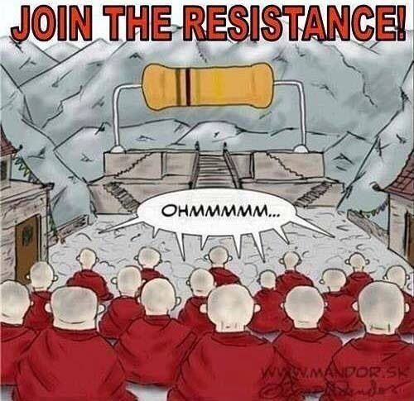
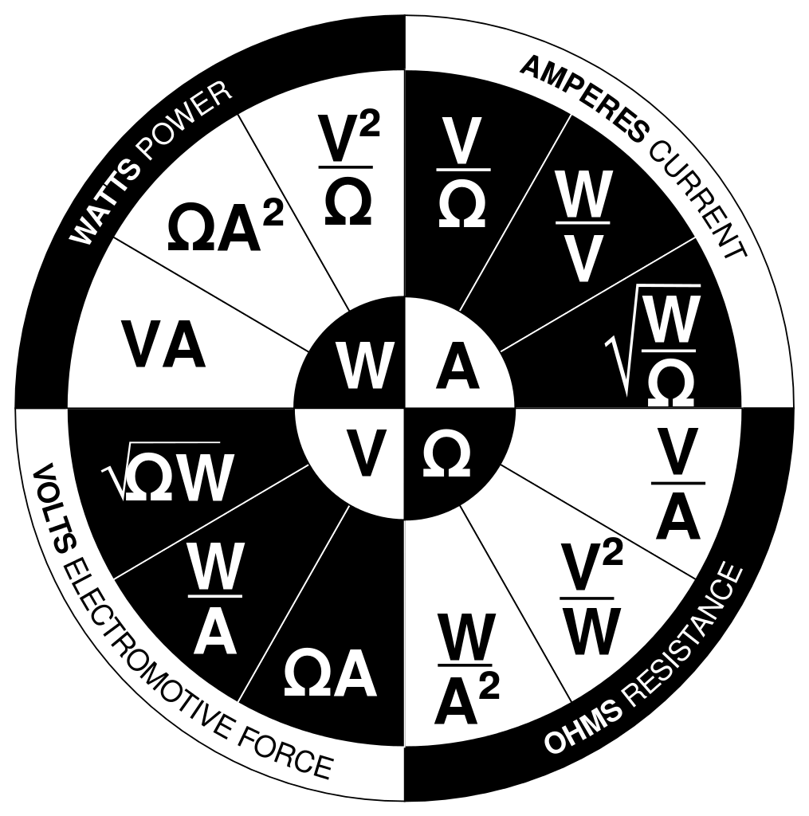
Ohm’s Law

Slide 4

Basic Circuit Elements
Power Supply: e.g. Batteries
Resistors: adds resistance, regulates voltages
Capacitors: stores charges and dissipates overtime
Inductors: maintains and regulates current and performs black magic
Operational Amplifiers (Op-Amp): amplifies voltages
Transistors: may act as an Op-amp or ‘electronic’ switch

Slide 5
Question
Which wire has more resistance?
A wire that skinny and long or a wire that is wide and short?

Slide 6
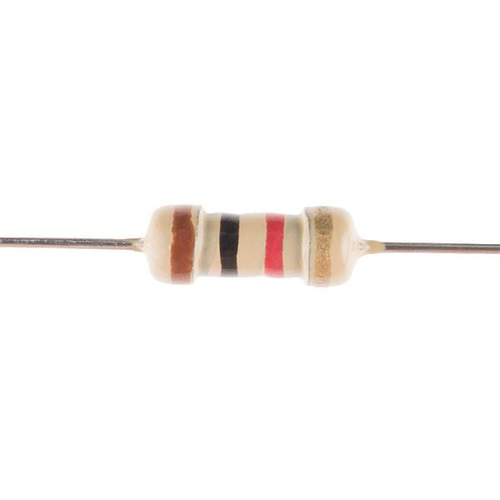
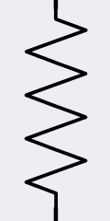
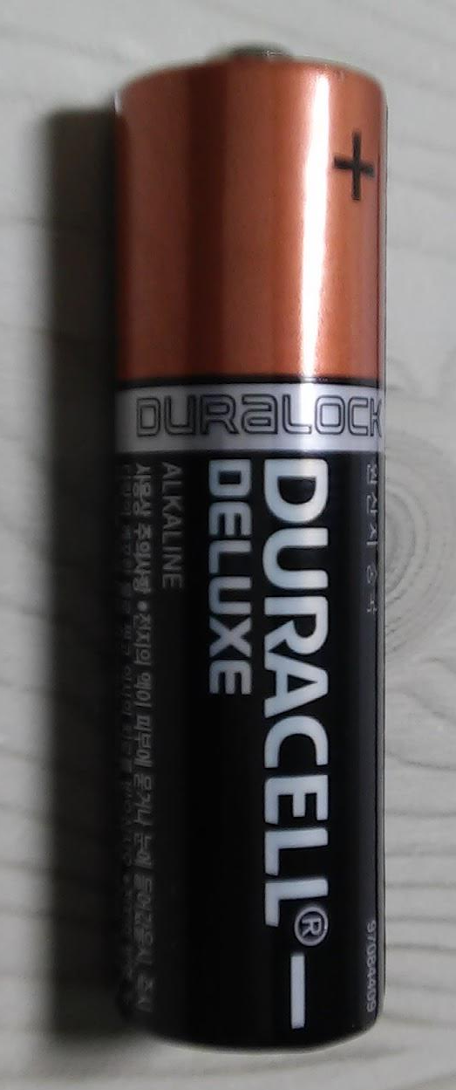
Power Supply
Resistors

Slide 7
Exercise Lv. 1
Single resistor circuit: what is the current? Then what is voltage

Slide 8
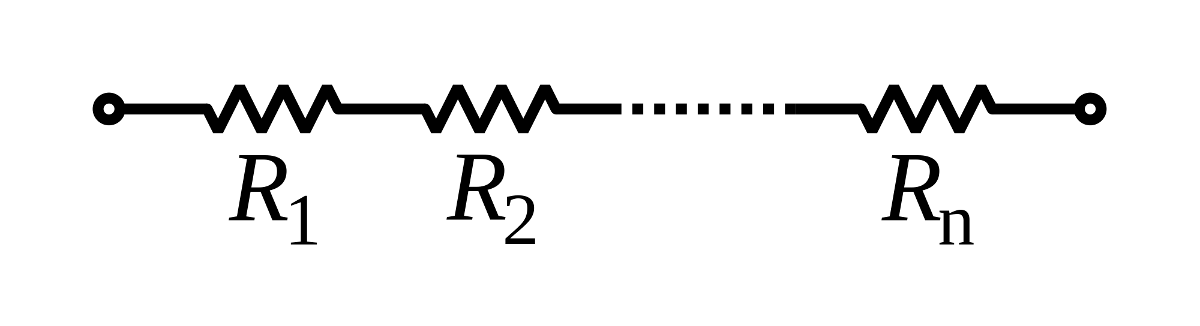
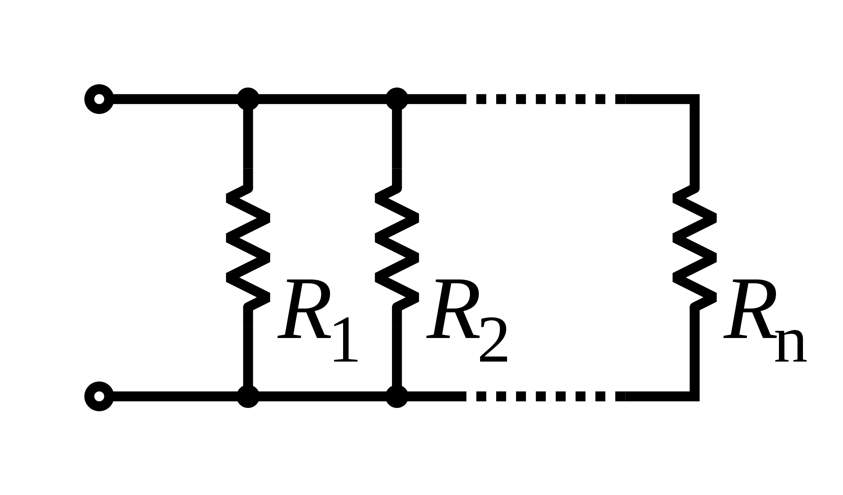
Series and Parallel
How to simplify
Series: Add resistances
Parallel: 2 methods

Slide 9
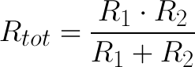

Parallel Resistances
Product over sum
Inverse of (sum of inverted resistances)

Slide 10
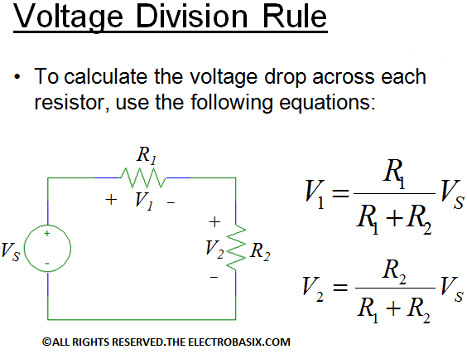
Voltage Division
To calculate the voltage drop across a component (resistor) use the following:

Slide 11
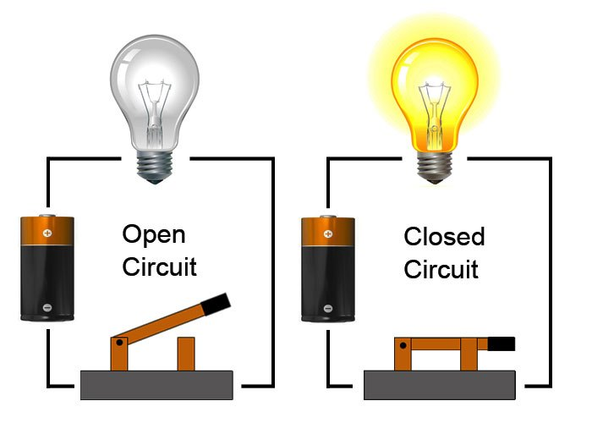
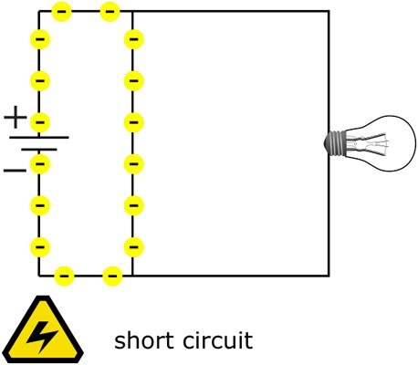
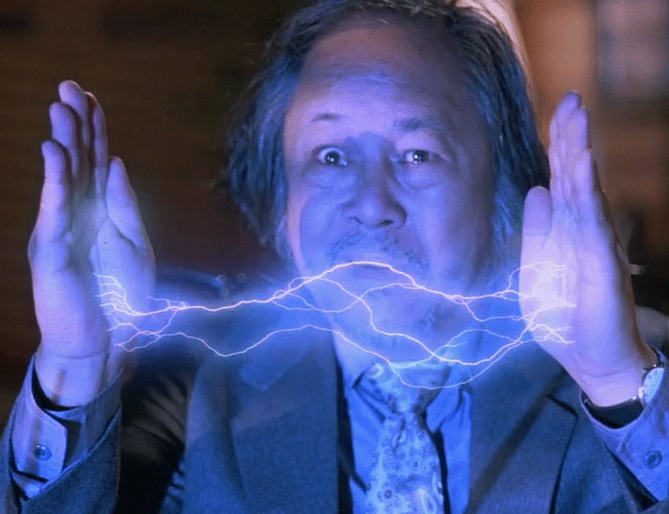
Open and short circuits

Slide 12
Exercise Lv. 2
Both series and parallel.

Slide 13
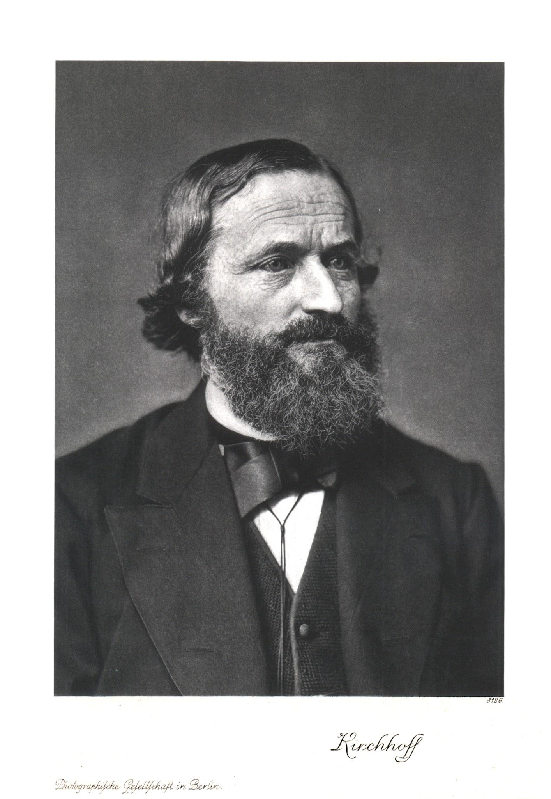
Kirchhoff’s Laws

Slide 14
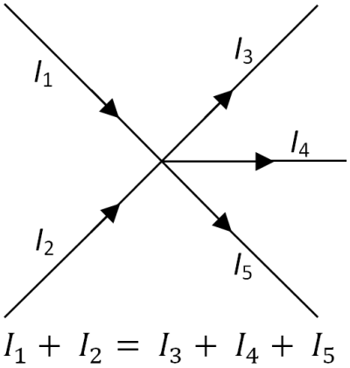
Kirchhoff’s Current Law (KCL)
Current in = Current out
Similar to Conservation of Energy

Slide 15
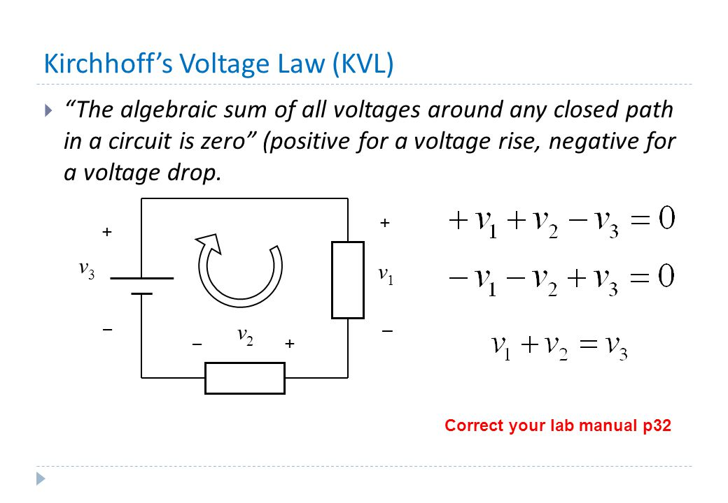
Kirchoff’s Voltage Law (KVL)

